Slide 1
Say Goodbye to the Static FFIEC CAT and Hello to the Dynamic CRI Profile October 24, 2024 | 2-3 PM ET Program will begin shortly

Slide 2
ABA Presentation
October 24, 2024

Slide 3
CRI is a Not-for-Profit

Slide 4
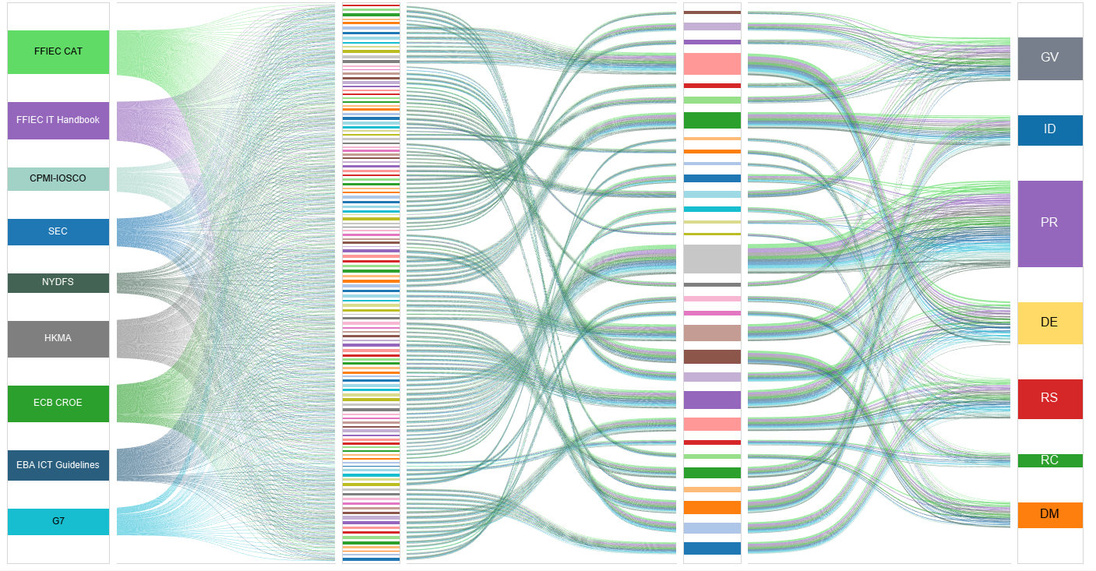
The Problem Space

Slide 5
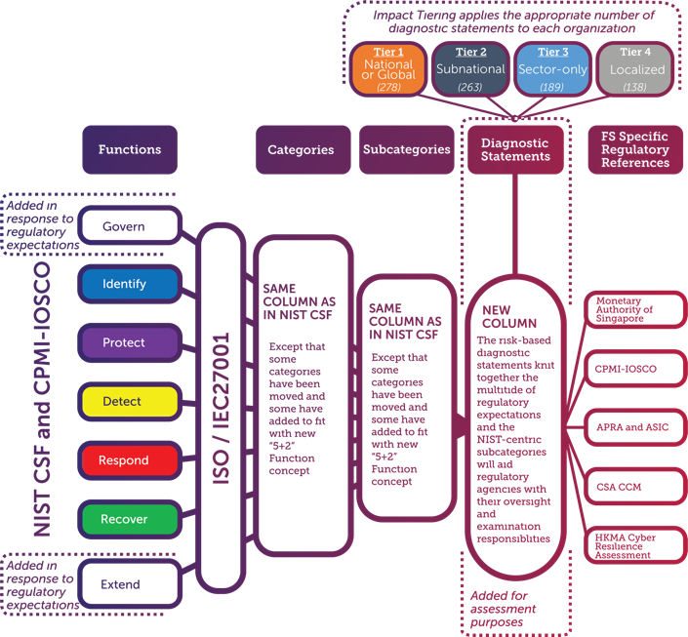
Profile Structure
To develop the Profile, the FSSCC led an industry-wide coalition to review and identify areas of regulatory overlap.
This effort included 50+ working sessions over two years
300 individual experts, representing over 150 financial institutions
An open-to-the-public NIST workshop particularized to the Profile
Included regulatory feedback and collaboration

Slide 6
The Outcome
Regulatory Environment
The CRI Profile
Regulatory Compliance
The CRI Profile incorporates over 2,500 cybersecurity-related state, federal, and international regulatory requirements…
…and harmonizes them into 318 diagnostic statements…
…allowing financial institutions to assess and demonstrate their regulatory compliance

Slide 7
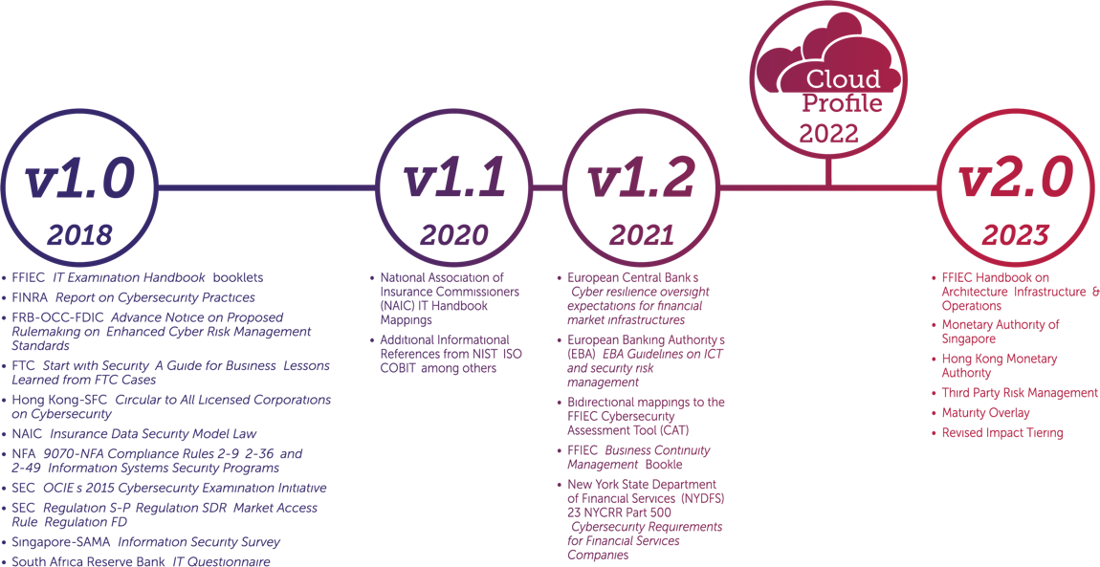
Profile Roadmap
2024
Version 2.0 Objectives
Address gaps in prior regulatory mappings
Expand the scope of the Profile to match the scope of an IT regulatory examination
Maintain consistency with the NIST Cyber Security Framework (CSF) version 2 update

Slide 8
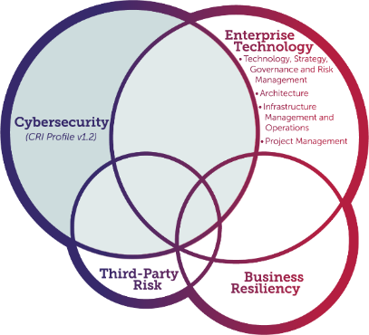
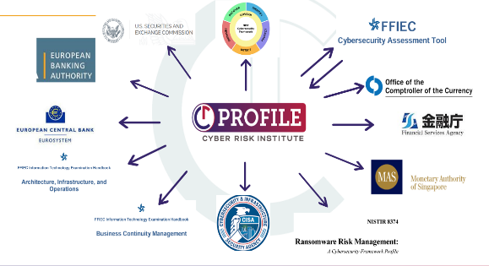
Profile v2.0: Enhanced Scope, Mappings, & Features
CRI Profile Subject Tag | Diagnostic Statements per Tag
#risk_management | 90
#policy_management | 58
#supply_chain_management | 53
#third_party_risk_management | 53
#critical_infrastructure | 51
#resilience | 51
#security_logging_monitoring_and_alerting | 50
#incident_management | 47
#review_assessment,_and_testing | 40
#mission_and_strategy | 36
#asset_management | 31
#disaster_recovery | 31
#threat_management | 31
#data_protection | 29
#vulnerability_management | 28
#risk_oversight | 26
#due_diligence | 25
#enterprise_risk_management | 25
#business_impact_analysis | 24
#identity_and_access_management | 23
#infrastructure_security | 23
#information_sharing | 22
#architecture | 21
#board_or_committee_oversight | 21
#staffing_and_resource_management | 21

Slide 9
Areas of Strategic Focus
Develop Products
Empower Members
Engage Regulators & Gov. Agencies
Maturity Model
Minimum Controls for Third Parties
Artificial Intelligence (AI) Framework
New Global Mappings from EU, Australia, Japan
Profile v2.0 and updates
In-Person Events
Ecosystem Relationships
Committees & Working Groups
Free Online Tool
Training Materials
Japan’s Financial Services Agency
Australia’s Prudential Regulation Authority, Securities and Investments Commission
US’s FRB, OCC, FDIC, NYDFS
Monetary Authority of Singapore
UK’s Bank of England, Prudential Regulation Authority, Financial Conduct Authority
Canada’s Office of the Superintendent of Financial Institutions
Hong Kong Monetary Authority

Slide 10
Regulatory Acknowledgements
The increased attention to the Profile has led some regulatory agencies to openly welcome the Profile as a compliance assessment framework.
This ranges from official, formal statements of acceptance to more discreet references to the Profile as an approved assessment tool. This includes:
NYDFS
FDIC
CFTC
FFIEC (which includes FRB, FDIC, NCUA, OCC and CFPB)
OCC
Reserve Bank of New Zealand
JFSA
“Supervised financial institutions may also consider use of industry developed resources, such as the Cyber Risk Institute’s (CRI) Cyber Profile, and the Center for Internet Security Critical Security Controls…. While the FFIEC does not endorse any particular tool, these standardized tools can assist financial institutions in their self-assessment activities.” –FFIEC CAT Sunset Statement

Slide 11
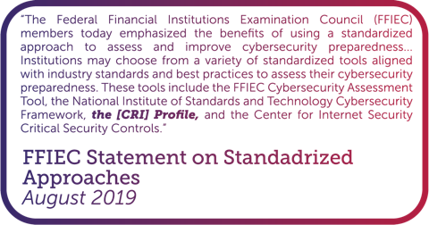

Slide 13
FFIEC CAT Sunset Statement
The FFIEC said that “several new and updated government and industry resources are available that financial institutions can leverage to better manage cybersecurity risks.”
Government resources referenced:
National Institute of Standards and Technology (NIST) Cybersecurity Framework (CSF) 2.0
Cybersecurity and Infrastructure Security Agency’s (CISA) Cybersecurity Performance Goals (CPGs) and CPGs for the Financial Sector
Industry resources referenced:
Cyber Risk Institute’s Profile for Financial Services
Center for Internet Security’s Critical Security Controls

Slide 14
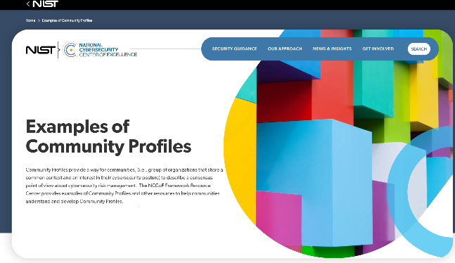
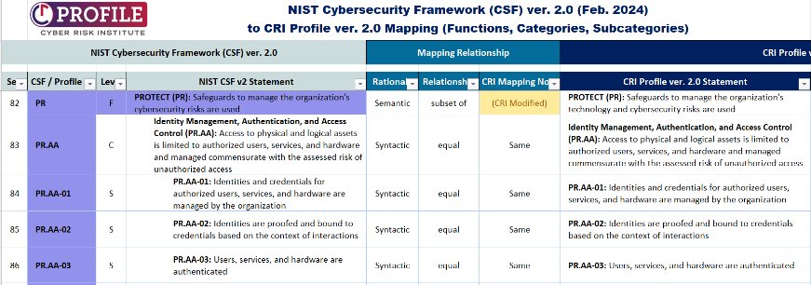
NIST CSF & the CRI Profile
Profile is a tailoring of the NIST CSF for the Financial Services Sector
“Since the NIST Cybersecurity Framework (CSF) was first released in 2014, it has included Framework Profiles as a key component.”
“Congratulations on publication of the [CRI Profile]. NIST encourages customization of our publications in ways that best meet the needs of each user. The [CRI Profile] builds upon the Cybersecurity Framework in ways that support the financial services community. NIST has found the Financial Services Sector Cybersecurity Profile Version 1.0 to be 1) correct with regard to Cybersecurity Framework Version 1.1, 2) supportive of a risk-based approach to cybersecurity, and 3) one of the more detailed Cybersecurity Framework-based, sector regulatory harmonization approaches to-date. NIST is happy to have supported the Financial Services Sector Coordinating Council in developing your work product. As financial services users implement your guidance, we should continue communicating, as user observations will likely inform future versions of the [CRI] Profile and the Cybersecurity Framework itself.” -NIST Letter to CRI

Slide 15
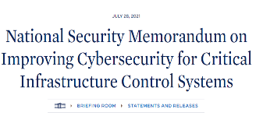
CISA CPGs & the CRI Profile
Minimum requirements for all 16 critical infrastructure sectors
CRI Profile used to develop financial sector CPGs
Identify
Protect
Protect (Continued)
Detect
Respond
Recover
1.A-Asset Inventory
1.B-Org. Cybersecurity Leadership
1.C-OT Cybersecurity Leadership
1.D-Improving IT & OT Cybersecurity Relationships
1.E-Mitigating Known Vulnerabilities
1.F-3P Validation of CS Control Effectiveness
1.G-Supply Chain Incident Reporting
1.H-Supply Chain Vulnerability Disclosure
1.I-Vendor/Supplier Cybersecurity Requirements
2.A-Changing Default Passwords
2.B-Min. Password Strength
2.C-Unique Credentials
2.D-Revoking Credentials for Departing Employees
2.E-Separating User & Privileged Accounts
2.F-Network Segmentation
2.G-Detection of Unsuccessful (Automated) Login Attempts
2.H-Phishing-Resistant MFA
2.I-Basic CS Training
2.J-OT Cybersecurity Training
2.K-Strong and Agile Encryption
2.L-Secure Sensitive Data
2.M-Email Security
2.N-Disable Macros by Default
2.0-Document Device Configurations
2.P-Document Network Topology
2.Q-Hardware and Software Approval Process
2.R-System Backups
2.S-Incident Response (IR) Plans
2.T-Log Collection
2.U-Secure Log Storage
2.V-Prohibit Connection of Unauthorized Devices
2.W-No Exploitable Services on the Internet
2.X-Limit OT Connections to Public Internet
3.A-Detecting Relevant Threats and TTPs
4.A-Incident Reporting
4.B-Vulnerability Disclosure/Reporting
4.C-Deploy Security.TXT Files
5.A-Incident Planning and Preparedness
Welcome to the Complete CPGs Matrix/Spreadsheet!
This is the master source document for the CPGs, including all reference information and resource links. Below is a brief description of the various tabs included in this document:
• “Function-aligned CPG Components” Tab: This is the main document. Its content closely mirrors the Core CPGs, with additional information regarding mapping to common frameworks and including other resources and references.
• “CSF subcat to CPGs map (CRI)” Tab: This tab, originally recommended to CISA by the Cyber Risk Institute (CRI), includes mapping/references from each subcategory in the NIST Cybersecurity Framework (CSF) to its corresponding CPG(s). It should be reiterated that CSF subcategories are merely references, and implementation of a CPG does not necessarily constitute fully addressing a given CSF subcategory, category, or function.

Slide 16
Financial Services Sector Specific Goals (FS-SSGs)
Financial sector tailoring of the CISA Cross-Sector Cybersecurity Performance Goals (CPGs)
Third-party risks are a key area of financial sector regulatory focus
The financial services SSGs are comprised of two levels that would act as steppingstones between the CPGs and minimum requirements for regulated financial institutions
FI
Regulatory Baseline
GLBA Data Protection
Count of Controls
Financial
Service
Baseline
Critical Infrastructure Minimum
Baseline
Tier 1
Tier 2
Tier 3
Tier 4
Moderate
Baseline
CPGs
Current CRI Profile Tiers
Financial Sector
Cross-Sector

Slide 17
CIS and the CRI Profile
Center for Internet Security’s Critical Security Controls v8.1 to CRI Profile v2.0 mapping

Slide 18
Differences between CAT & Profile
FFIEC Cybersecurity Assessment Tool | CRI Profile
Domains → Assessment Factors → Components → Declarative Statements | Functions → Categories → Subcategories → Diagnostic Statements → Regulatory Mappings
Cyber-only scope | Cyber & IT scope
Inherent risk profile | Impact tiering questionnaire (based on systemic risk)
Maturity levels | Tier levels (and future maturity model)
Some mappings | Aligned to NIST CSF & Global standards and regulatory requirements
Will be sunset | Updated continuously

Slide 19
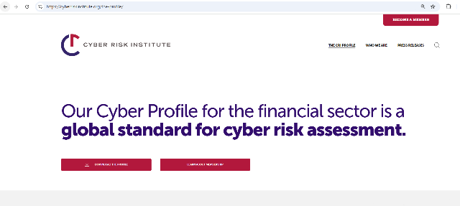
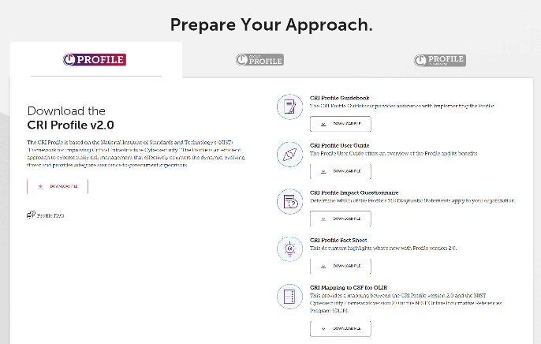
Ok, but where do I start?
Website: www.cyberriskinstitute.org
Document suite:
Spreadsheet
Guidebook
Fact Sheet
Impact tiering questionnaire

Slide 20
Impact Tiers
Four-tier model
Tier 1 – National/Super-National Impact
Tier 2 – Sub-National Impact
Tier 3 – Sector Impact
Tier 4 – Localized Impact
Typical characteristics include:
Process data for less than 1 million individuals, or less than 1% of the country’s population
Localized presence (e.g., community banks)
Services provided do not affect the ability of other institutions to provide services
Based on
Risk
Interconnectedness
Tier 1 - 318
Diagnostic Statements
Tier 2 - 311
Diagnostic Statements
Tier 3 - 282
Diagnostic Statements
Tier 4 - 208
Diagnostic Statements

Slide 21
CRI Profile Structure
Functions
GOVERN (GV)
IDENTIFY (ID)
PROTECT (PR)
DETECT (DE)
RESPOND (RS)
RECOVER (RC)
EXTEND (EX)
Identity Management, Authentication, and Access Control (PR.AA)
Awareness and Training (PR.AT)
Data Security (PR.DS)
Platform Security (PR.PS)
Technology Infrastructure Resilience (PR.IR)
Categories
PR.AA-01
PR.AA-02
PR.AA-03
PR.AA-04
PR.AA-05
PR.AA-06
Subcategories
PR.AA-01.01
PR.AA-01.02
PR.AA-02.01
PR.AA-03.01
PR.AA-03.02
PR.AA-03.03
Diagnostic Statements
PR.AA-04.01
PR.AA-05.01
PR.AA-05.02
PR.AA-05.03
PR.AA-05.04
PR.AA-06.01
PR.AA-06.02

Slide 22
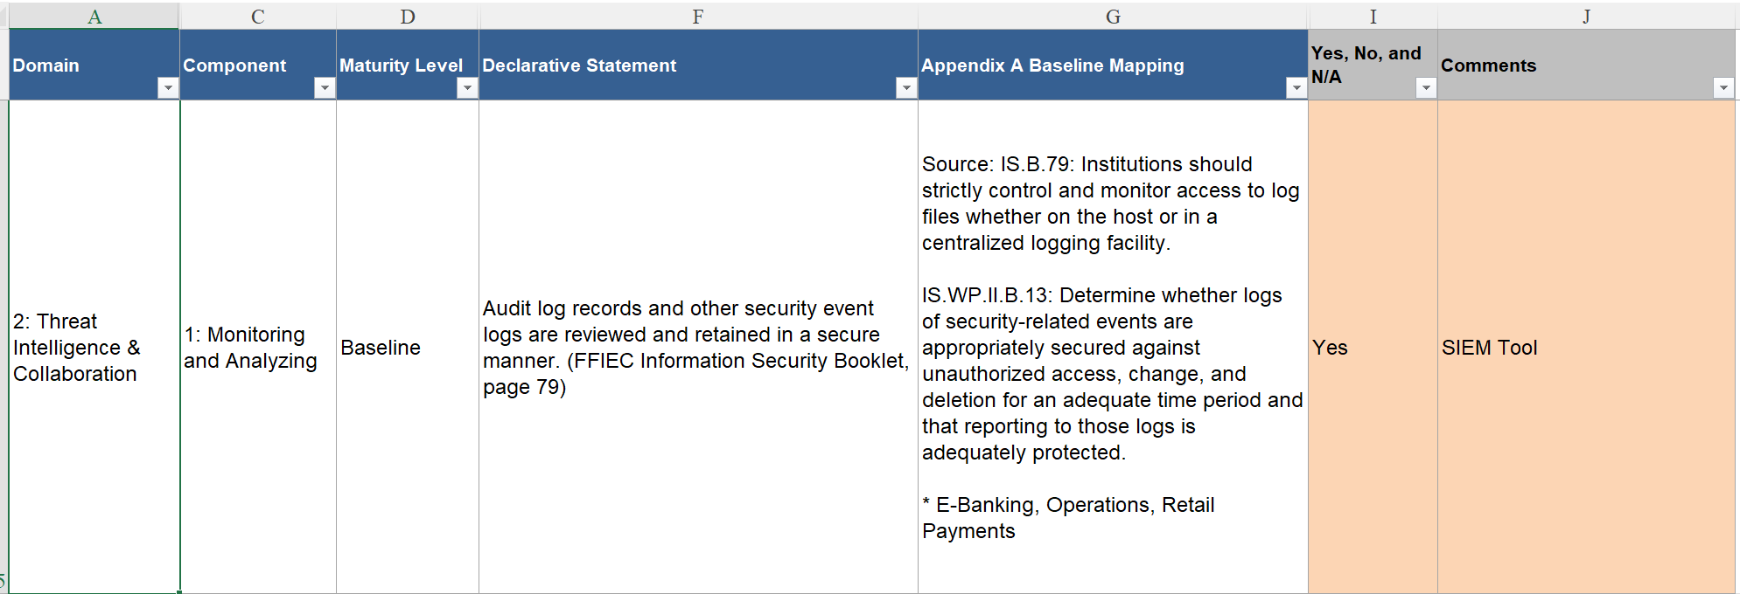
CAT Example

Slide 23
CAT-to-Profile Mapping
Profile-to-CAT Mapping

Slide 24
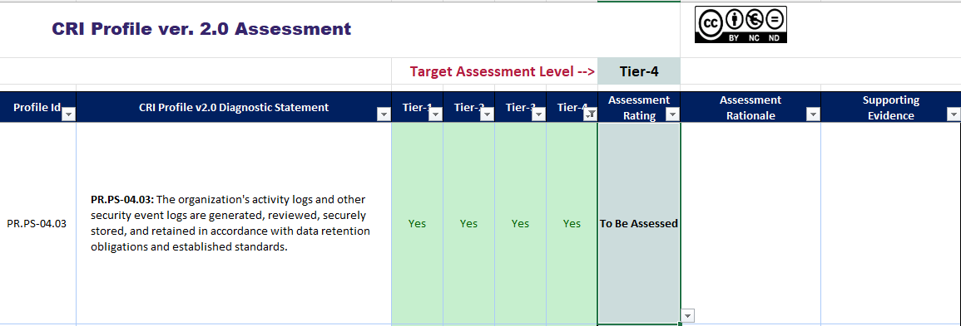
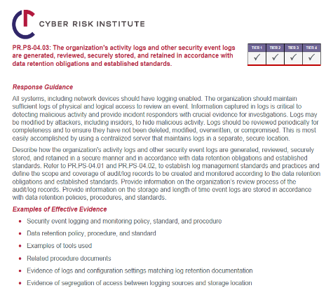
Navigate to Profile Assessment View
Review the response guidance from the Guidebook
Select the drop down for 8 options for responses
Fill in response under “Assessment Rationale”
Input the artifacts to demonstrate compliance (e.g., SIEM tool referenced in CAT evidence)

Slide 25
Populates Assessment Response Summary Tab with Results
 |  |  | Response Distribution
 |  | CRI Profile Total: | 2 | 1 | 2 | 2 | 3 | 0 | 1 | 198 | 109
Level | Profile Id | Function / Category / Subcategory | Yes | No | Partial | Yes-Risk Based | Yes-Compensating Control | Not Tested | I Don't Know | To Be Assessed | Not Applicable
F | GV | GOVERN | 0 | 0 | 1 | 2 | 1 | 0 | 1 | 60 | 32
F | ID | IDENTIFY | 0 | 0 | 0 | 0 | 0 | 0 | 0 | 37 | 27
F | PR | PROTECT | 2 | 1 | 1 | 0 | 2 | 0 | 0 | 43 | 25
F | DE | DETECT | 0 | 0 | 0 | 0 | 0 | 0 | 0 | 14 | 10
F | RS | RESPOND | 0 | 0 | 0 | 0 | 0 | 0 | 0 | 12 | 4
F | RC | RECOVER | 0 | 0 | 0 | 0 | 0 | 0 | 0 | 10 | 1
F | EX | EXTEND | 0 | 0 | 0 | 0 | 0 | 0 | 0 | 22 | 10

Slide 26
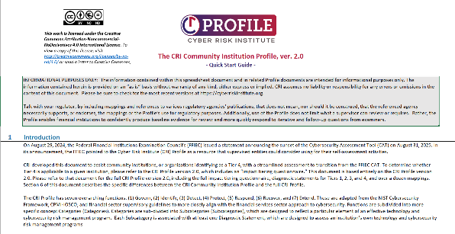
Suggested Practices
Tailor for your needs
Tier up
Reduce number of responses
Socialize internally and externally
Leverage community support
Build upon the self assessment
Use tools to help

Slide 27
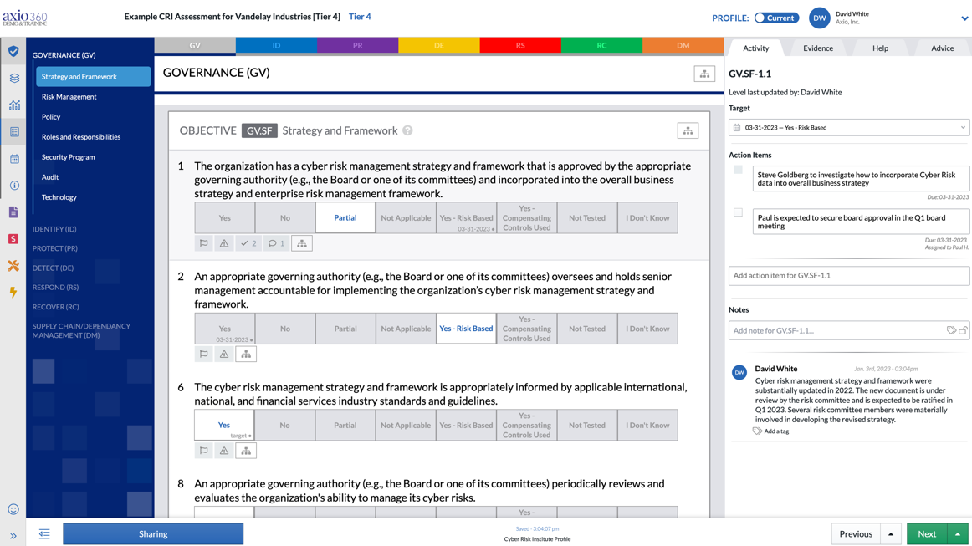

Slide 28
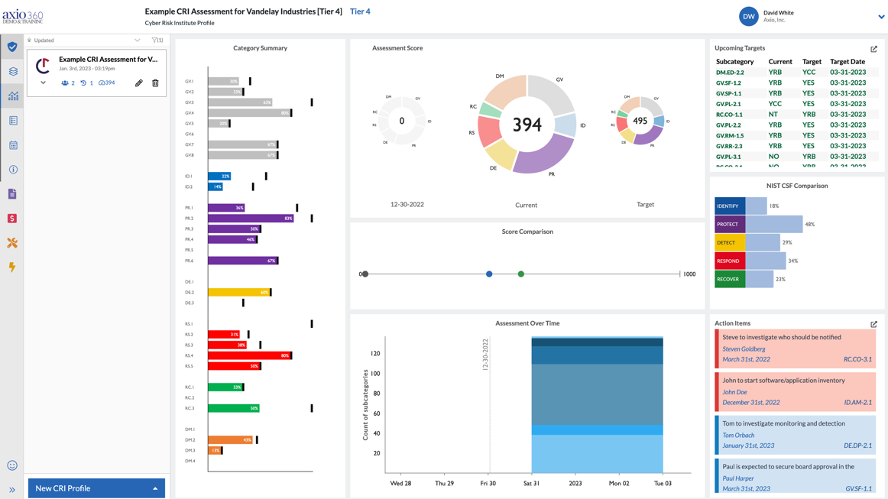

Slide 29
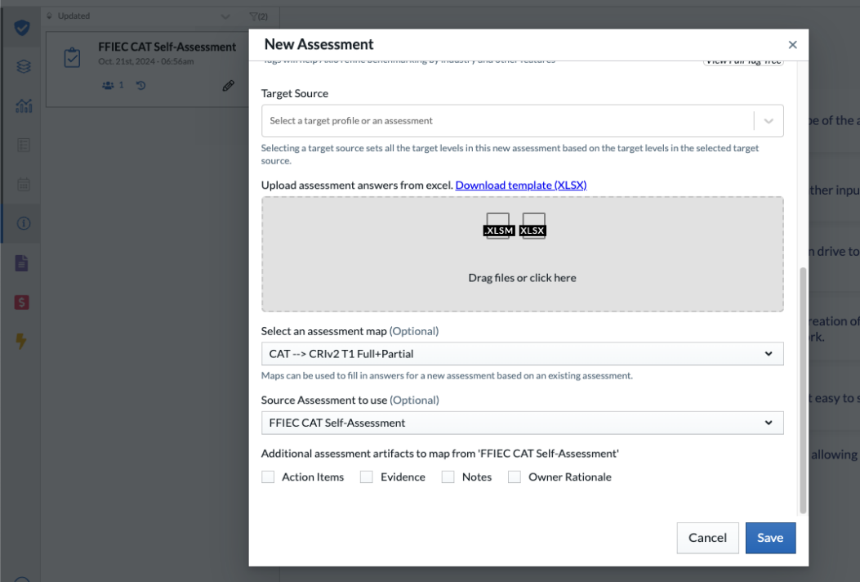

Slide 30
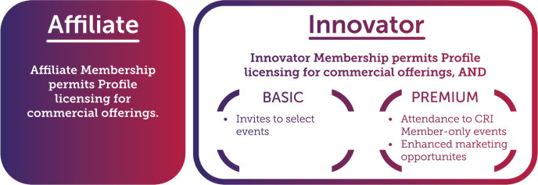
Profile Licensing Programs
Current Participants:
Launched Innovator and Affiliate program to support Profile-based offerings within third-party vendors
Participating firms license the Profile for commercial use, and contribute to the wider community

Slide 31
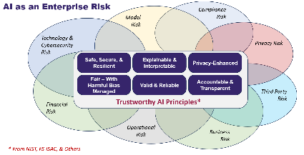
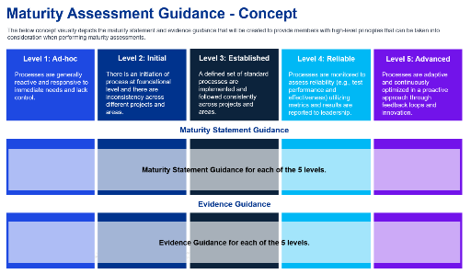
What’s Next? AI & Maturity
Financial Sector AI RMF
Maturity Model
CRI will be leading an effort to operationalize the NIST Artificial Intelligence (AI) Risk Management Framework (RMF).
The NIST AI RMF’s Functions, Categories, and Subcategories will provide the base structure for the organization of controls.
It will include a staged approach to AI adoption and implementation representing the increasing levels of organizational risk for which controls need to increase in extent and rigor.
It will also include FS-tailored control guidance and specifications incorporating and synthesizing relevant concepts, guidance, and recommendations from other trusted information sources (e.g., OCC Model Risk Guidance, FS-ISAC, ATLAS, OWASP, ISO, etc.)
The AI guidance would also be mapped to the CRI Profile and other relevant FS frameworks, guidance, or regulation.
CRI is developing a maturity model that includes 5 levels ranging from Level 1 (Ad-hoc) to Level 5 (Advanced) that provides guidance around the types of characteristics relating to a given level.
The maturity model will incorporate key factors, such as governance, process, people, and technology.
Organizations will have the option of selecting a weighted or non-weighted score.
CRI anticipates finalizing the maturity model in early 2025.

Slide 32
Appendix: Impact Tiering

Slide 33
Impact Tiering
Tier 1 National/Super-National Impact: High-level of systemic importance as determined by countries and multi-national bodies.
Is your institution designated as systemically important to the Financial Services Sector?
Does your institution consistently participate in (e.g., hold, clear, settle, or transact) at least five percent of the value of transactions in a critical market within a national economy?
318 Diagnostic Statements

Slide 34
Impact Tiering
Tier 2 Sub-National Impact: High-degree of interconnectedness within complex networks; providing services critical to others
Does your institution provide a product or service to businesses in other industries or to other institutions in the Financial Services Sector for which the compromise of your product’s or service’s confidentiality, integrity or availability is reasonably likely to cause failure to meet payment/settlement obligations, prolonged disruption affecting multiple country securities markets, loss of key financial data, widespread loss of trust, etc.?
Is your institution owned or partially owned by a foreign held entity located in a country of particular interest?
Does your institution have facilities located within a country of particular interest that allow access to your network infrastructure from that facility?
Does the number of individuals whose data your institution processes exceed 5 million or 2% of the country's population which your institution operates business in, whichever is lower?
311 Diagnostic Statements

Slide 35
Impact Tiering
Tier 3 Sector Impact: High-degree of interconnectedness but has a moderate impact on others
Does your institution provide a product or service to other institutions within the Financial Services Sector for which the compromise of your product’s or service’s confidentiality, integrity, or availability is reasonably likely to cause complete unavailability of your services would affect quality but not ability to perform your own primary functions or another institution’s functions, impact on sector trust and confidence or delivery of critical services.
Do you provide products or services to financial institutions that involve customer data processing or storage?
Does your institution process data for 1 million individuals (up to 5 million) or 1% (up to 2%) of the country's population which your institution operates business in, whichever is lower?
282 Diagnostic Statements

Slide 36
Impact Tiering
Tier 4 Localized Impact: Limited impact on the sector as a whole.
Process data for less than 1 million individuals, or less than 1% of the country’s population
Localized presence (e.g., community banks)
Services provided do not affect the ability of other institutions to provide services
208 Diagnostic Statements

Slide 37
Appendix: Document Suite

Slide 38
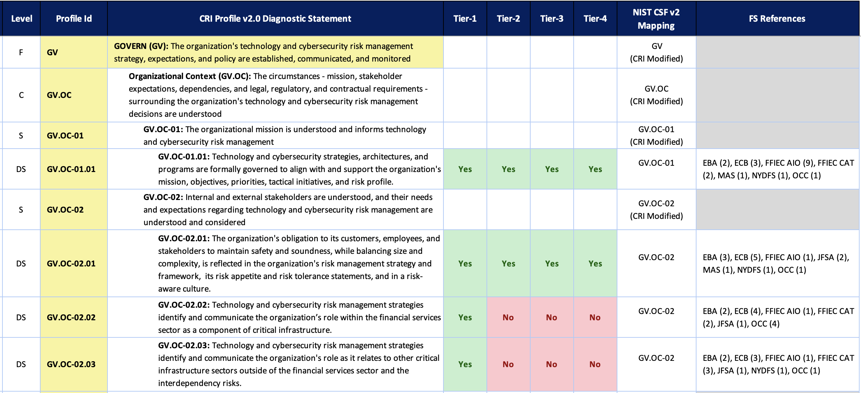
CRI Profile Workbook

Slide 39
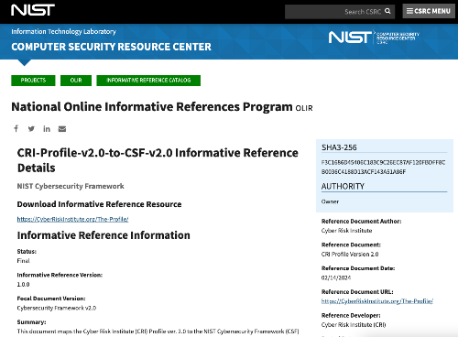
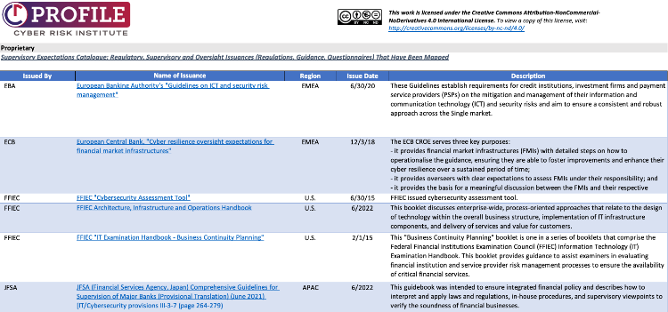
Mappings
Regulatory, Supervisory, and Oversight Issuances that have been mapped to the Profile are included in the Profile workbook.
The CRI Profile v2.0 to NIST CSF v2.0 mapping is included in the NIST Online Informative References Catalog.

Slide 40
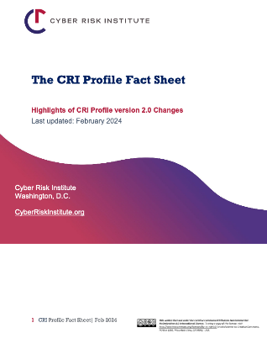
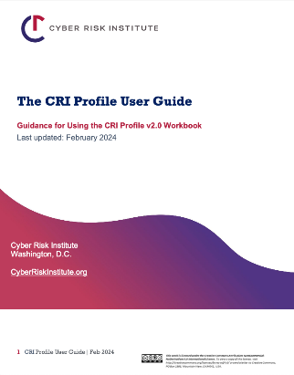
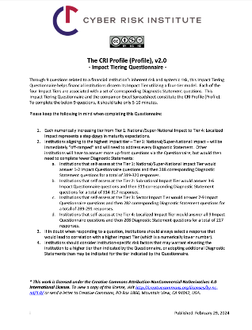
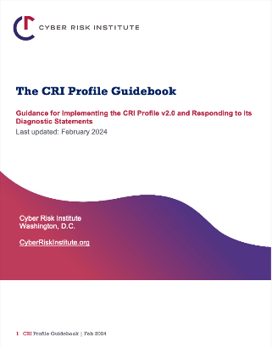
Guidance Documents
CRI Profile Guidebook
CRI Profile Fact Sheet
CRI Profile Impact Tiering Questionnaire
CRI Profile User Guide
Available for free at www.cyberriskinstitute.org

Slide 41
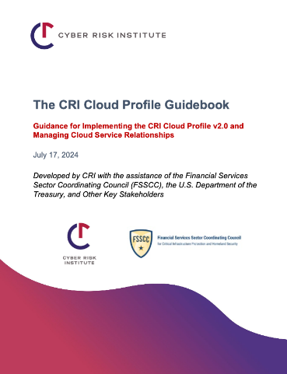
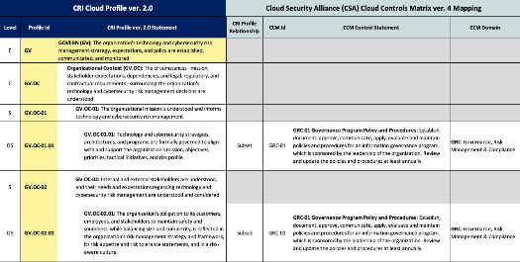
CRI Cloud Profile v2.0
Extension of the CRI Profile developed with cloud service providers, FSSCC, CSA, and other partners
Actionable cloud security guidance for firms looking to implement or strengthen existing cloud technologies and operations
Includes a shared responsibility checklist and implementation tool

Slide 42
Use Cases and Benefits
Profile
Cloud Profile
Provides a way to assess an organization’s technology and cybersecurity program
Streamlines regulatory examinations and improves outcomes
Complements risk assessment and risk management activities
Drives policy and procedure structure and content
Enables alignment of an organization’s program and resources
Usable across lines of defense
Tailorable to an organizations complexity and business needs (tier up or borrow diagnostic statements from other tiers)
Develop a checklist for your next major cloud procurement (discussions with CSP on Shared Responsibilities Model)
Develop standard template contract language for cloud & other technology procurements
Plan resource skill requirements for upcoming cloud implementation phases
Develop plan for ongoing cloud provider monitoring
Train technical staff about how traditional data center controls translate to cloud environments
Organize cloud implementation assurance documentation for internal audit or regulator review
Highlight key areas for targeted analysis in cloud risk assessments
Communicate cloud risk to executives and the board in the familiar context of the NIST Cybersecurity Framework

