Slide 1


Sustaining Visibility
Women Lead Symposium
July 30, 2026
~ Donna Rustigian Mac ~
Strengthening the Leader Behind the Vision

Slide 2

A Great Leader Focuses On…
Leadership Requires Both
Notes:
WHY – WHAT - Medicinal---does not take the place of medical advice. Good news… practical skills to recognize and regulate how you’re feeling. NOTES…CHAT

Slide 3
Your Inner Work
STOP
1. Stress Level
Breathe
2. Constricted or expanded?
Posture
3. Mindful or MindFULL?
Focus
Notes:
Copy?

Slide 4
External Expression
T
TALK
Are you a more inductive or deductive communicator?

Slide 5
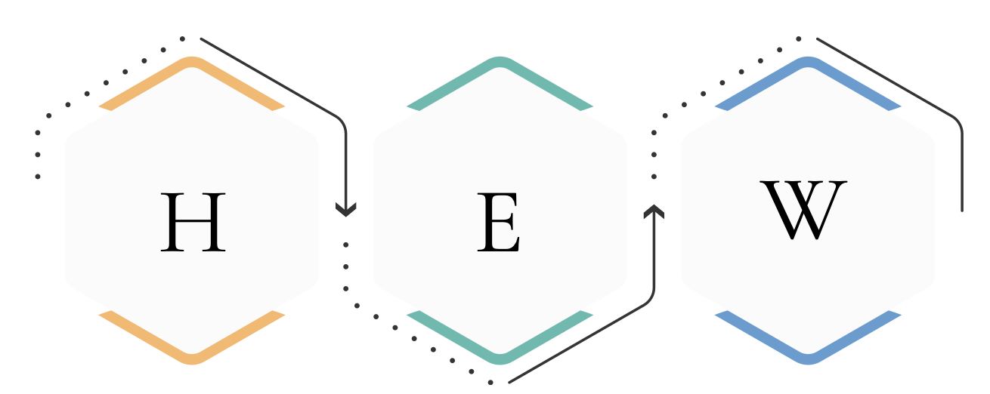
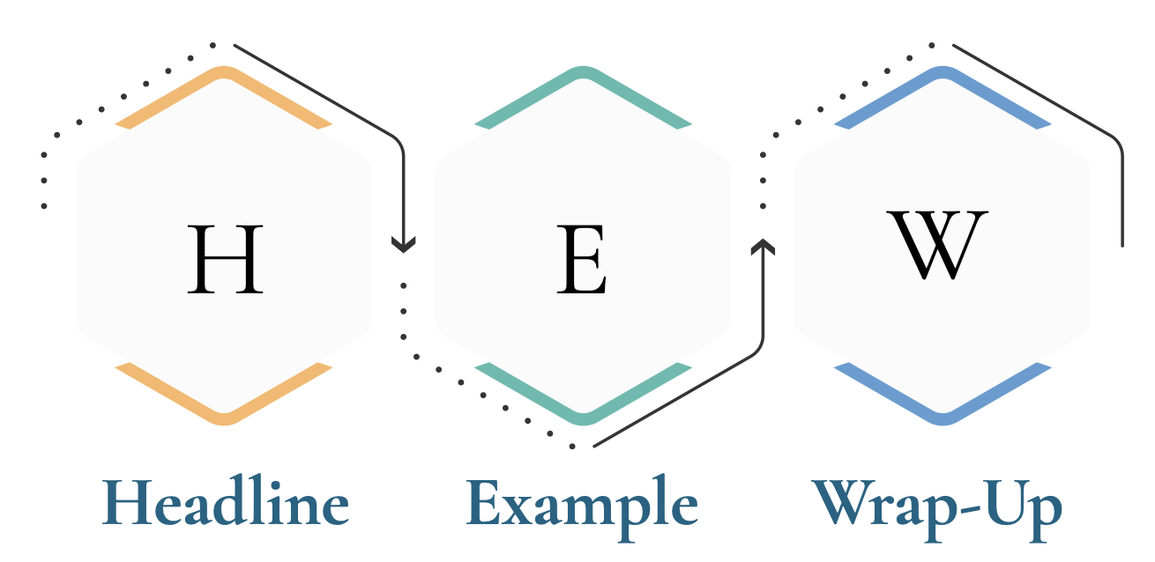
Deductive Communication

Slide 6
O
Leadership Communication
is a
Choice
Options
Notes:
WHY? No one wants to be told they have to change.

Slide 7
STOP
Stress
Talk
Options

Slide 8
Progress
🔥Cortisol
✨Serotonin
Progress + Physiology

Slide 9
In Summary
~ One Skill/Tool ~
A Great Leader
Your Inner Work
Your External Expression
STOP

Slide 10
Take What You Learned
Choose 1. Then another…
There is no perfect
Pay it forward

Slide 11
Sustaining Visibility
Women Lead Symposium
~ Donna Rustigian Mac ~
THANK YOU!
Strengthening the Leader Behind the Vision

