Slide 1

Business Imposter Social Media Graphics
Add the name of your company where it says “[company name]”
Export slides as PNGs or JPGs
  File > Export > Change file type > PNG or JPG
For questions on the toolkit or campaign, reach out to Kira Krown (kkrown@ftc.gov) and Gema de las Heras (gdelasheras@ftc.gov).

Slide 2

[Company name] joined the Elder Justice Coordinating Council’s Never EVER Campaign
ejcc.acl.gov/imposters #StopBizImposters
Notes:
Social media post: [Company name] is joining government agencies and organizations across the country to raise awareness about imposter scams. Learn the signs of an imposter scam so you can avoid them. #StopBizImposters ejcc.acl.gov/imposters

Slide 3


Join [company name] in the fight against imposter scams. Report scams at
ReportFraud.ftc.gov
#StopBizImposters
EJCC’s Never EVER Campaign
Learn more ejcc.acl.gov/imposters
Notes:
Social media post: Did you see or experience an imposter scam? Report it at ReportFraud.ftc.gov. Your report makes a difference. #StopBizImposters

Slide 4
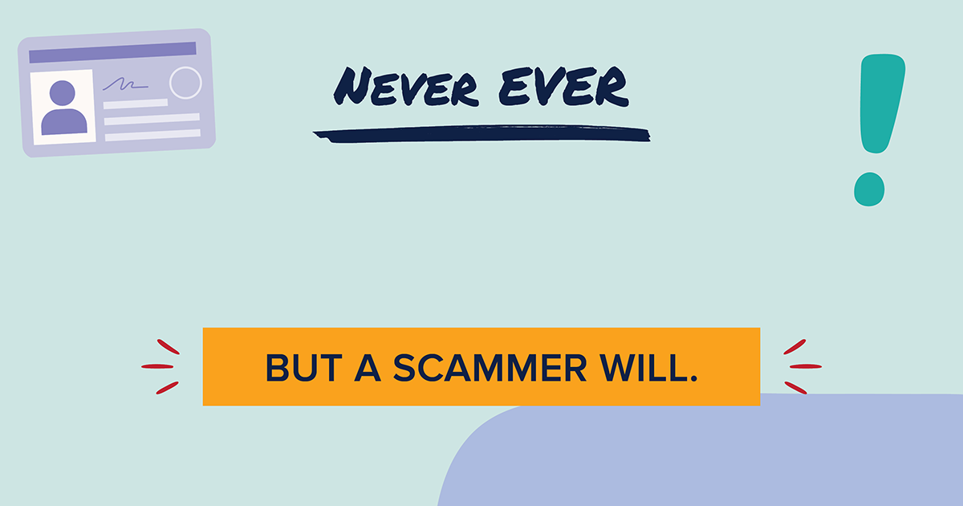
Never EVER will [company name] contact you out of the blue to ask for money or personal information.
ejcc.acl.gov/imposters #StopBizImposters
Notes:
Social media post: Did someone contact you out of the blue asking for money or personal information? That’s a sign of an imposter scam. Learn more signs so you can avoid them. #StopBizImposters ejcc.acl.gov/imposters

Slide 5
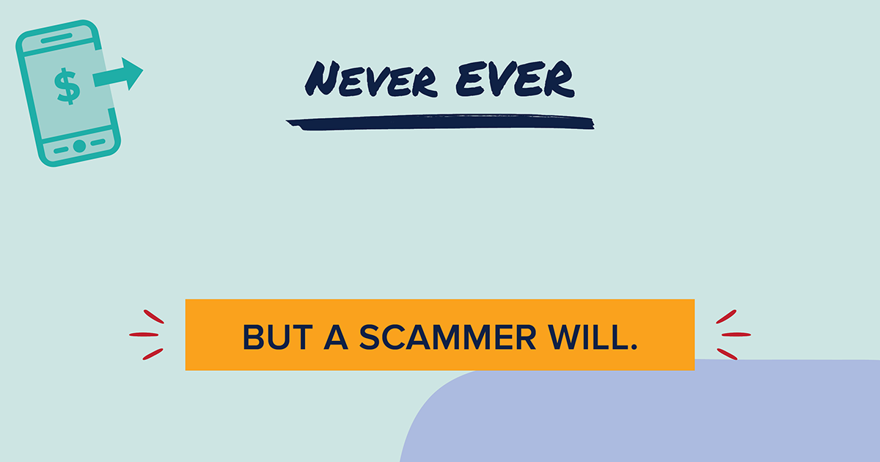
Never EVER will [company name] insist that you pay only with a payment app, cryptocurrency, a wire transfer service like Western Union or MoneyGram, or a gift card.
ejcc.acl.gov/imposters #StopBizImposters
Notes:
Social media post: Pay attention to how someone asks you to pay. If they demand payment only by wire transfer, payment app, crypto, or gift cards, that’s a sign of an imposter scam. #StopBizImposters ejcc.acl.gov/imposters

Slide 6
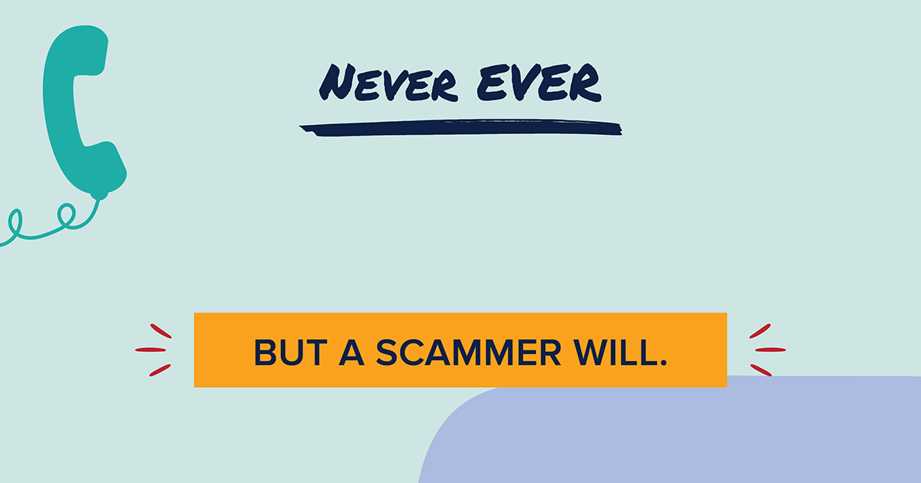
Never EVER will [company name] tell you to keep your phone conversation a secret.
ejcc.acl.gov/imposters #StopBizImposters
Notes:
Social media post: Did a caller say there’s suspicious activity or a problem with your account and tell you to keep the call a secret? No legitimate business will do that. Only a scammer will. #StopBizImposters ejcc.acl.gov/imposters

